Slide 1





The Simple's Takeout for the Poor
FIT5192 Enterprise and internet applications development
Wenchao Li 30074444
Jiaxin Zeng 30074355
2019.08.28

Slide 2



1
Introduction to Website
2
Master Page Design
Content
3
Login Authentication
4
Page Display

Slide 3

The introduction of our website
Our website is dedicated to providing people with better service, let them eat better and live better. At the same time, we will provide free takeaways for the poor and set up corresponding schedules on the website to remind them. This is a amazing website!

Slide 4
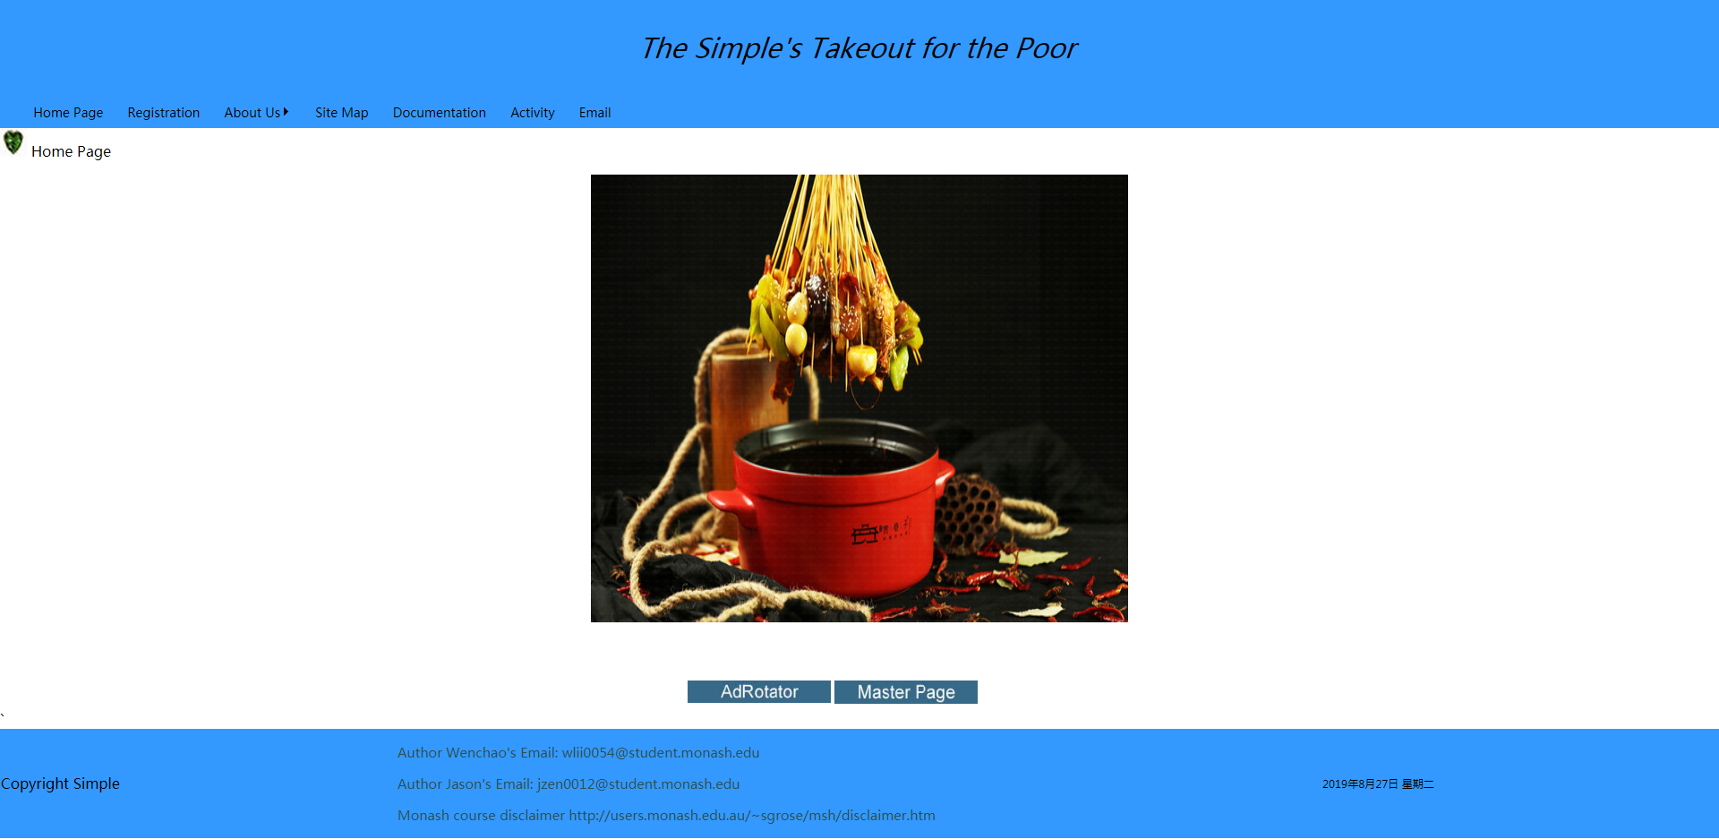

Master Page Design
Put the common features in the master page
Header, footer, menu, breadcrumbs
Copyright, author email and disclaimer

Slide 5
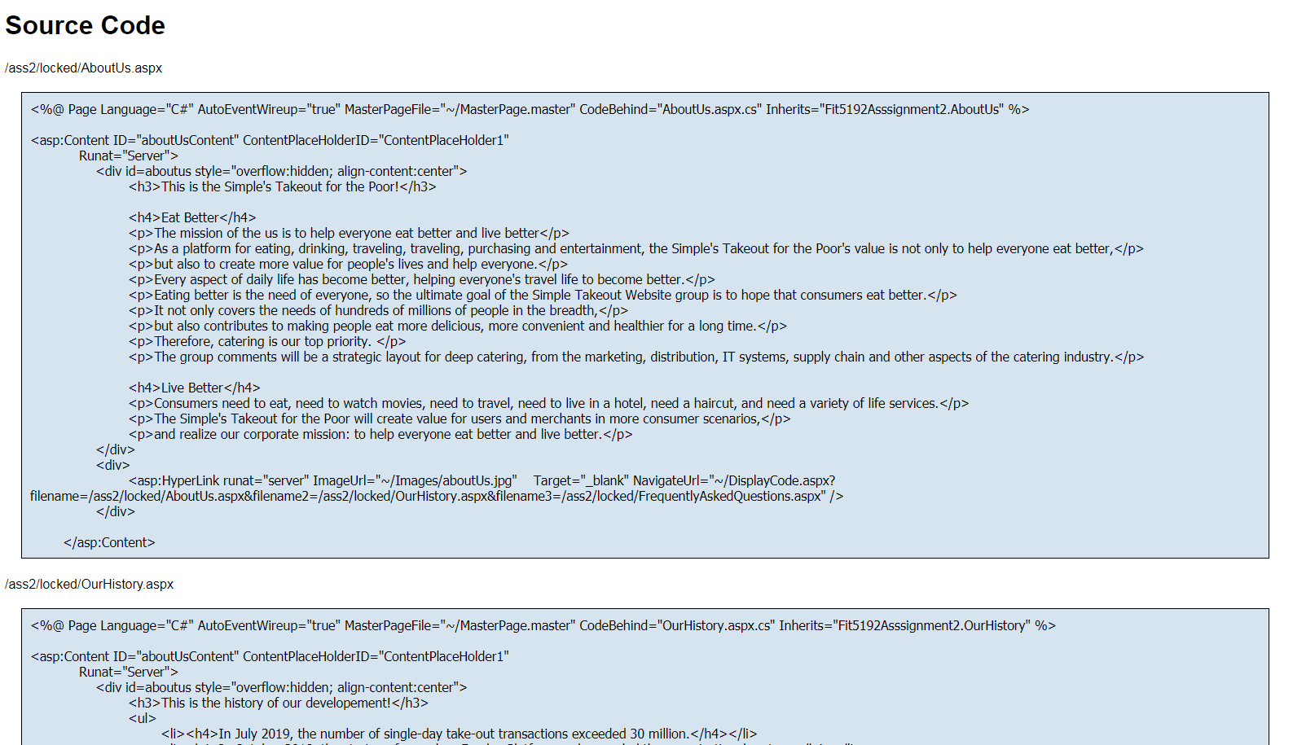
Dynamicaly Display Code Function
We write display code function in separate file and transmit the url parameters to call when needed

Slide 6

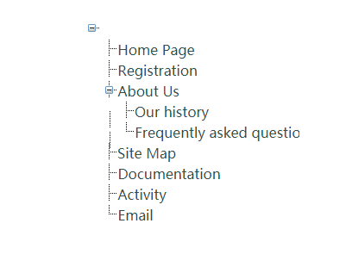

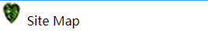
SiteMap Page
Tree view in SiteMap Page
BreadCrumbs
Files needed
Web.sitemap
SiteMap.aspx

Slide 7
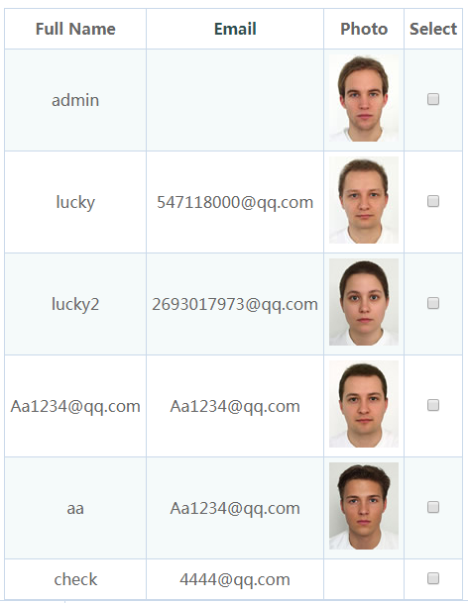
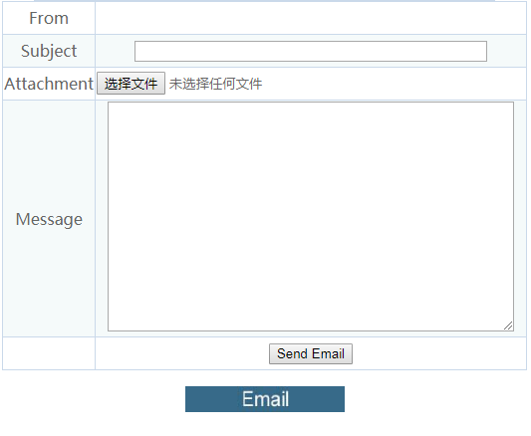
Email Page
We have achieved the email function by sending email to qq smtp host

Slide 8
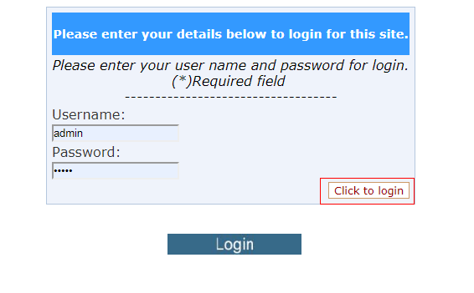
Login Authentication
By configuring the authentication in Web.config file, the unloged user can only access the HomePage and Registration Page

Slide 9
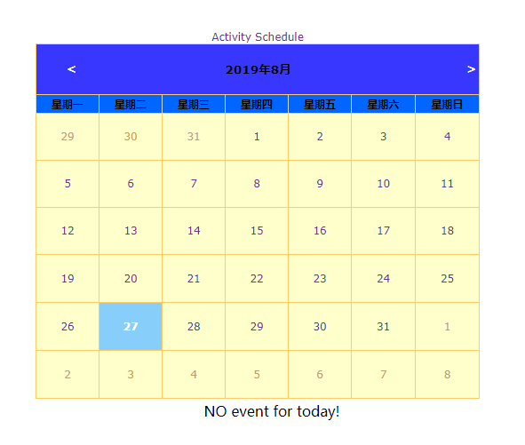
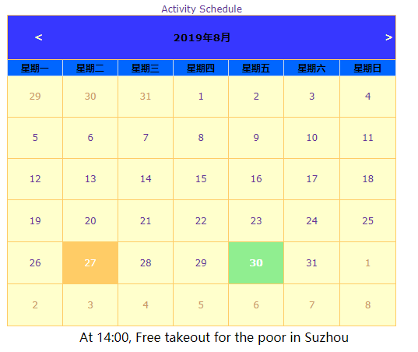
Calendar
We implemented the calendar function with different color to check activity

Slide 10
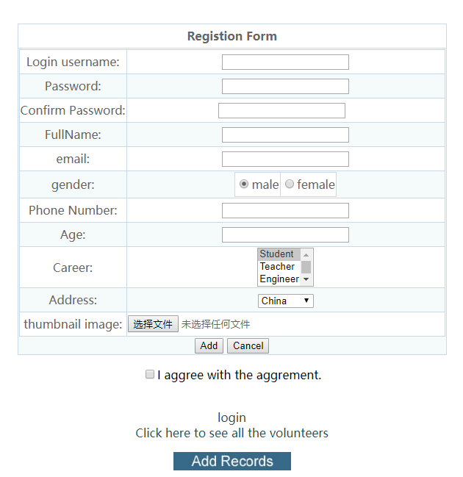
Registration
All validators
Multiple components

Slide 11
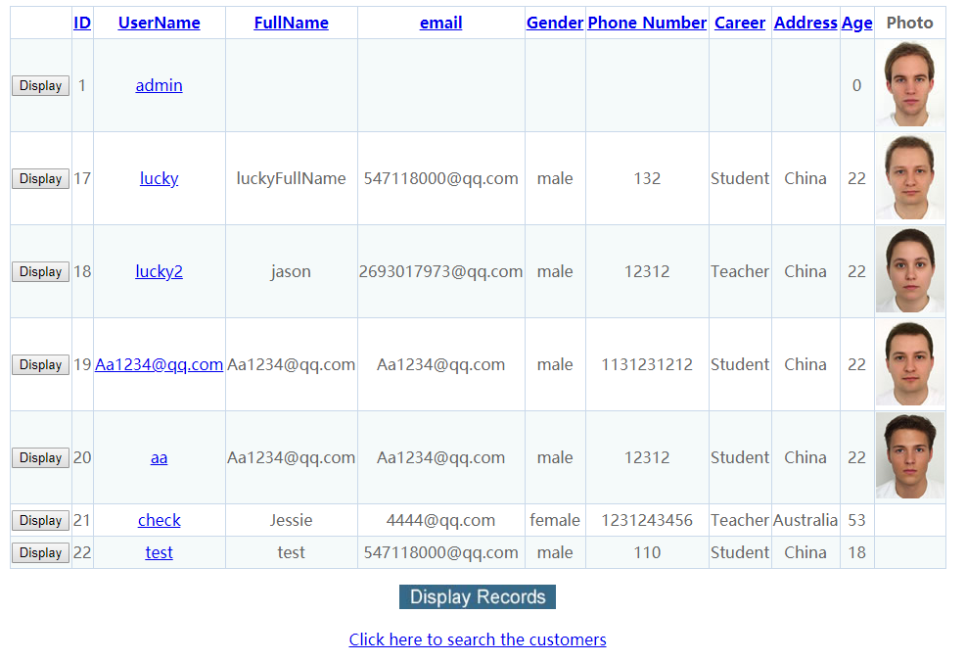
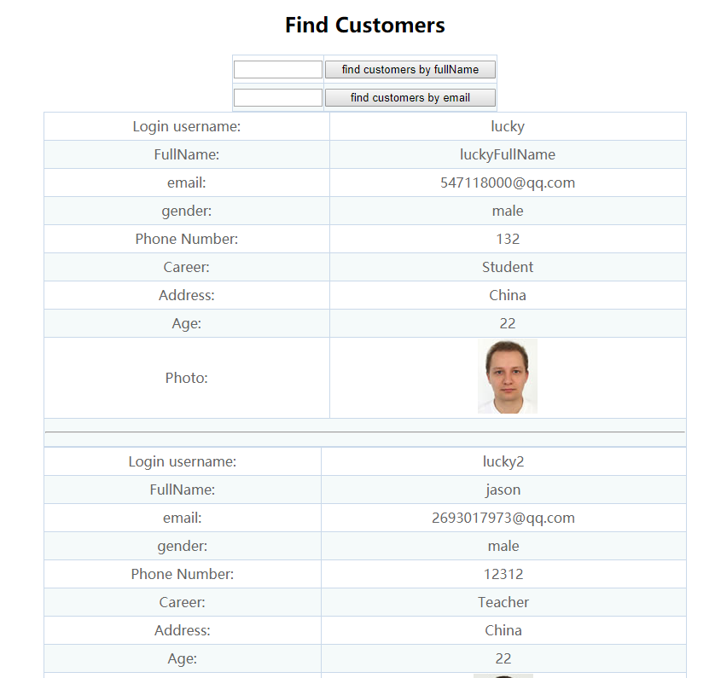
Records
Records and Searching function.

Slide 12
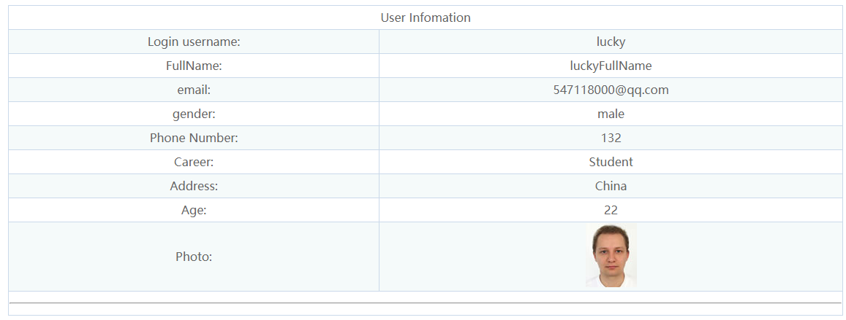
Single record
We provide a page to check the single record

Slide 13



CSS
SKIN
SCRIPT
Calendar
Table
Login

Slide 14
Thank You

